Slide 1


Capitalizing on
Big Data Disruption
May 9, 2019
AIM Lunch and Learn

Slide 2
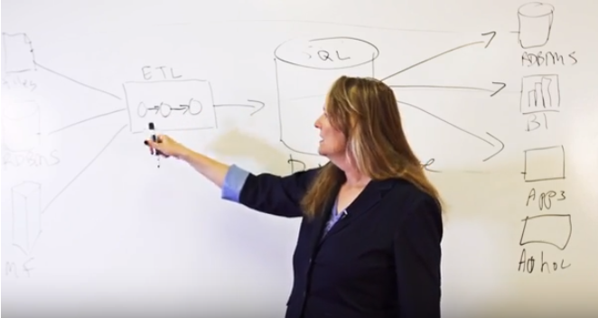
Introduction
Paige Roberts, Vertica Open Source Relations Manager
20 years in data management software
6 years as a teacher before that
6 months at Vertica. Before: Syncsort, independent consultant, Hortonworks, Bloor Group, Actian, Pervasive, CSC, Data Junction
Can’t seem to decide what I want to be when I grow up:
  Tech Support
  Tech Writer
  Software Trainer
  Software Engineer
  Consultant
  Product and Technical Marketer
  Product Manager

Slide 3






The future belongs to the fast
“Digital Darwinism is unkind to those who wait.”
- Ray Wang, Constellation Research, June 2015

Slide 4




Data is Changing the Game in the Idea Economy
The world’s largest taxi company owns no vehicles.
The world’s most popular media owner creates no content.
The world’s largest custom craft retailer owns no inventory.
$715 million in loans without a bank.

Slide 5

Because data is transforming the way businesses in every industry operate, grow and stay competitive

Slide 6
Big data waves of disruption
Big Data
Analytics
Machine
Learning
Data Warehouse
Modernization
Big Data / Hadoop
Cloud and
Hybrid
Internet
of Things
Embedded
Analytics

Slide 7

Data Warehouse Modernization Wave
How you know you’re in it?
Paying a lot for legacy systems
Constant tuning of analytics
Fear of more analytics
Inability to handle more data
Solution
Modern data management platforms that scale indefinitely
Leverage open source
Information lifecycle management

Slide 8
Legacy Data Warehouse Challenges
Increasing data volumes
More concurrent users
High cost of legacy solutions
Analytics demand increase

Slide 9
Modern Data Warehouse
What it really means to modernize your data warehouse
Scalable
Flexible
Advanced Analytics
Affordable increments
Can consume data fast
Easy to get in, easy to get out
Less data movement
Without extensive coding
Time-series
Machine Learning
Extensible to custom functions
Backup and disaster recovery to Cloud
Geospatial
Can handle concurrency
Supports Information Lifecycle Management
Leverage all data from Hadoop (ORC, Parquet, Avro, …), JSON, S3 …
Cloud Capable
No lock-in to a particular cloud
Takes full advantage of cloud economics

Slide 10





Scalable – High performance with high concurrency
Fear of more users or growing data volumes is a thing of the past
Scale Data Volumes
Vertica Advanced Analytics Platform
Scale Users
+
+
SQL Database
Analytics & ML
Query Engine
  Get data quickly enough to act upon it, explore your data interactively,
  and enable everyone to make their own data-driven decisions
  Get data quickly enough to act upon it, explore your data interactively,
  and enable everyone to make their own data-driven decisions

Slide 11



Essentials of a Modern Data Warehouse
Extreme performance, open architecture, advanced analytics, and freedom from underlying infrastructure.
Parallel loading capability for large or continuous data
A versatile license that you can take with you
Bringing SQL analytics to Apache Hadoop
Integration with Kafka, Spark, BI, ETL, and other tools
Machine learning directly in the database
Ability to separate compute and storage resources

Slide 12
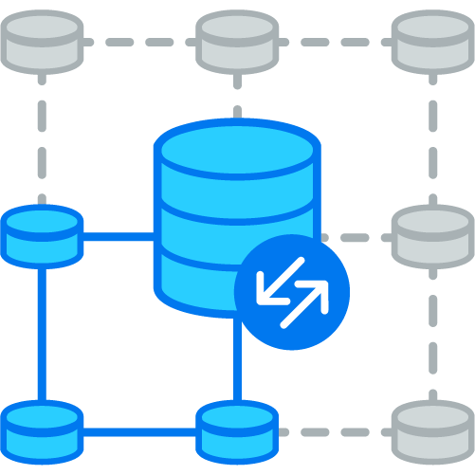
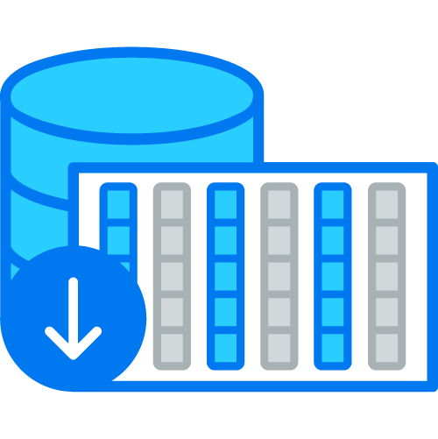
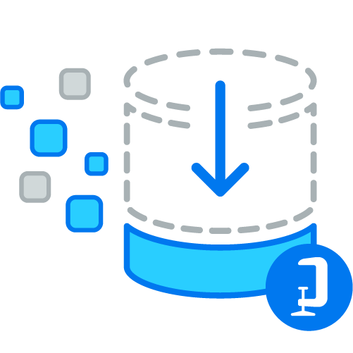
Architecture Built for Performance and Scale
Massively Parallel Processing
Columnar
Storage
Advanced
Compression
Run queries in parallel across infrastructure and scale-out linearly for faster performance or more users
Increase query speed over traditional row-based storage systems by reading only the necessary data
Advanced compressions algorithms reduce disk space by up to 90% and improve performance by reducing costly I/O

Slide 13



  Goal: Empower everyone to better serve customers – designers, buyers, planners, retail store managers
  Cut data load time in half or more – from 3 - 4 hours to 90 mins max
  Generate store sales tracking reports
  90 - 400 times faster
  Perform queries 60-80x faster
  for merchandise allocation and distribution of inventory across retail locations
  Extend analytics to the business front lines via a visual, easy-to-use mobile application – 80% of global workforce can now access
Notes:
8 May 2019
13
Before: Data capped at 3 TB at a high price tag, up to 5 hours to load data daily, complex queries didn’t always complete
After: No data cap, 36TB capacity, lower TCO, data load in less than 90 mins, complex queries always complete – 60 – 80X faster
Result: Extend analytics to the front line. Everyone has access. Embed analytics in online store and mobile app. All up and running in 3 months.
trend analysis, inventory management, and personalization and customer engagement
“Do you have that in my size?”
query with details about size-level inventory requires only 30 seconds compared to 30 to 40 minutes in the past.
(60 – 80X faster)

Slide 14


  Health information solutions like Millenium. User workflow analysis to improve efficiency and quality of patient care, supporting government regulations.
Goal: Expand and grow Millenium.
  On modest hardware, concurrency at
  450 simultaneous users
  6,000% faster analysis of timers helps Cerner gain insight into how physicians and others use Millennium and make suggestions about using it more efficiently so users become more efficient physicians
  Rapid analysis of 2 million alerts daily helps Cerner head off problems before they happen
Notes:
8 May 2019
14
Improve efficiency and quality of patient care by speeding analysis of system performance timers and client workflow data
Cerner® solutions are licensed by more than 9,000 facilities worldwide.
Cerner Corporation’s Millennium® solution platform not only provides Electronic Health Records for health care providers, but also helps those providers optimize processes to speed the delivery of care and eliminate waste and error.
Cerner Millennium, the company’s flagship product, integrates nearly 60 solutions into a patient-centric suite focused on the Electronic Health Record and clinical workflows.
“Some Health Facts users would issue a query at 5 p.m. as they leave for the day, hoping they would have a result when they return at 8 a.m. the next morning. With Vertica, those query times are down to two or three minutes.”
DAN WOICKE
Director of Enterprise System Management
Cerner Corporation
More data and more analysis: Cerner has already nearly doubled the number of records it analyzes on a daily basis. That growth
Cerner
https://www.vertica.com/wp-content/uploads/2017/01/Cerner-Success-Story.pdf
will continue.

Slide 15

Big Data/Hadoop Wave
How you know you’re in it?
Looking for inexpensive places to keep data
More types of data – structured and unstructured
Handling data of unknown value
Hadoop excitement
Solution
Must support Spark
Must support ORC, Parquet, JSON, etc.
Leverage HDFS or S3 for cold data
Information lifecycle management
Query in place without moving data

Slide 16
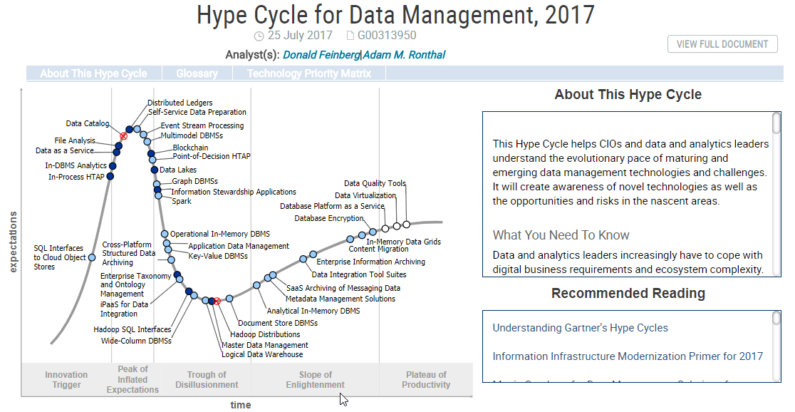
Hadoop Hype
2008
There’s this new thing called Hadoop
Can Hadoop replace the data warehouse?
Can Hadoop replace ETL?
Has Hadoop failed to deliver the goods?
2011
2013
2018
https://www.gartner.com/document/3388326

Slide 17




Hadoop is not synonymous with Big Data
 | Hadoop’s days are not numbered. Just Hadoop as we know it.
 | Matthew Aslett

Slide 18



Enterprises often realize only 10-15% of the value expected on their big data investments
Silos and Lack of Alignment
Technology Gap
Translating Data to Value
41%
of systems cannot process large volumes of data from different sources*
  57%
  “obtaining the necessary skills and capabilities needed” - top 3 challenge for Hadoop**
  55%
  “determining how to get value from big data” - top 3 challenge with big data***
* PWC – Capitalizing on the promise of Big Data – 1/2013
** Gartner – Survey Analysis: Hadoop Adoption Drivers and Challenges – 5/2015
*** Gartner – Survey Analysis: Practical Challenges Mount as Big Data Moves to mainstream – 9/2015

Slide 19
Hadoop can…
Provide fantastic low-cost storage for big data
Serve as an excellent platform for data transformation / ETL
Deliver analytics for a minimal number of users
Hadoop cannot…
Provide robust advanced analytics
Support hundreds or thousands of concurrent users
Achieve the performance you probably thought it could

Slide 20

Key Capabilities
What it takes to DO big data – Database vs Open Source Stack
SQL, R, Python
(time series, geospatial)
Embedded Machine Learning
Visualization Partners
HIVE, SPARK, Python, QGIS
User
High Availability MPP Database
(on-premises, cloud, hybrid)
Distributed Analytics
(compute with storage, compute flexible)
Drill/Impala/Presto
Core
Fair Scheduler, Map/Reduce Scheduler
ORC, PARQUET
Workload Management
(Concurrency support, load and query simultaneously)
Optimization
(Columnar, Compression, Flattened Tables, …)
Management Console
(visualize and manage queries/pools/nodes)
Security and Encryption
(Apache Sentry, Kerberos, SecureData, Voltage)
Backup
Amazon S3, High Availability
Ambari and YARN
HDFS
Administration
Multi-model
(Internal, Orc, Parquet, JSON, Avro, …)
ILM
(write to Parquet, S3, query internal and external data)
Apache Kite
PIG, Kafka
Ingestion
Insert, COPY, ODBC/JDBC, Kafka constant load, ETL, Spark, …

Slide 21
Do you need a query engine or a database, or both?
Query engine
Database
Optimized SQL Standard Query Engine
Query engine
ACID
HIVE (SQL-like)
Workload Management
DATA
DATA
Query engine
Query engine
Scalable Storage like HDFS or S3
Scalable Storage
Scalable Compute
Cloudera Impala, Presto, Pivotal Hawq,
Apache Drill, Spark SQL, etc.
Microsoft SQL Server, Vertica,
Oracle, Teradata, Amazon Redshift, etc.

Slide 22
Do you need a query engine or a database, or both?
Query engine
Database
Optimized SQL Standard Query Engine
Query engine
ACID
HIVE (SQL-like)
Workload Management
DATA
DATA
Query engine
Query engine
Scalable Storage like HDFS or S3
Scalable Storage
Scalable Compute
Cloudera Impala, Presto, Pivotal Hawq,
Apache Drill, Spark SQL, etc.
Vertica

Slide 23



Analyze all your data without the gymnastics
No longer move your data or settle for limited or partial views of your data landscape
+
+
SQL Database
Analytics & ML
Query Engine
Unify analytical insights regardless of data location
Disparate data exists across the organization in data warehouses, data lakes, cloud storage, data science tools, business applications and more

Slide 24



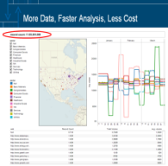


Common Modern Architecture for Batch and Streaming Analytics
Distributed Messaging System
MPP Analytics Database
Analytics / Reporting
Data Generation
OLTP/ODS
Raw Data Topics
JSON, AVRO
ETL
Stream
processing
Spark Connector
Logs
(Apps, Web, Devices)
Processed
Data Topics
User tracking
SQL on Hadoop
Operational Metrics
ORC
Parquet

Slide 25
Common Modern Architecture for Batch and Streaming Analytics
Distributed Messaging System
MPP Analytics Database
Analytics / Reporting
Data Generation
OLTP/ODS
Raw Data Topics
JSON, AVRO
ETL
Stream
processing
Spark Connector
Logs
(Apps, Web, Devices)
Processed
Data Topics
User tracking
SQL on Hadoop
Operational Metrics
ORC
Parquet

Slide 26
Common Modern Architecture for Batch and Streaming Analytics
Distributed Messaging System
MPP Analytics Database
Analytics / Reporting
Data Generation
OLTP/ODS
Raw Data Topics
JSON, AVRO
ETL
Stream
processing
Spark Connector
Logs
(Apps, Web, Devices)
Processed
Data Topics
User tracking
SQL on Hadoop
Operational Metrics
ORC
Parquet

Slide 27
Common Modern Architecture for Batch and Streaming Analytics
Distributed Messaging System
MPP Analytics Database
Analytics / Reporting
Data Generation
OLTP/ODS
Raw Data Topics
JSON, AVRO
ETL
Stream
processing
Spark Connector
Logs
(Apps, Web, Devices)
Processed
Data Topics
User tracking
SQL on Hadoop
Operational Metrics
ORC
Parquet

Slide 28

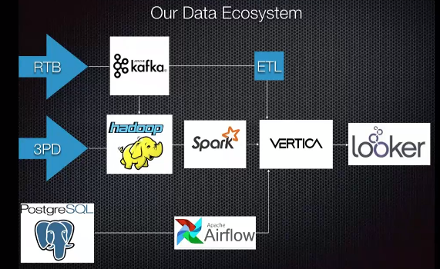
Serve the right digital ad to the right person at the maximum value
Notes:
Simpli.fi architecture – real-time bidding = RTB – 100’s of millions/hour, billions/day – stored in Parquet
3pd = third-party data
postgreSQL – app data – definitions of programs being run

Slide 29
Cloud and Hybrid Wave
Solution
Scale compute up or down as needed on the Cloud.
An analytics platform that is deployable anywhere
  On commodity hardware
  Across multiple cloud platforms
  Natively on Hadoop
How you know you’re in it?
Business people are setting up their own IT
Business is looking for faster than normal turn-around
You’re looking hard at hardware costs
Rapid growth, constantly scaling up data centers
Looking for places to run extra workloads
  End of quarter
  End of year
  Special projects

Slide 30



The sun is shining on the Clouds
Cloud economics offer budget relief for certain workloads
Data storage and compute are the first stop on the journey
Cloud based analytics stacks enter the market

Slide 31



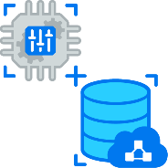
What is Driving People to the Clouds?
First Generation
Using the cloud as a data center
Second Generation
Separation of compute and storage
Amazon AWS EC2
Amazon EC2
Microsoft Azure
Google Cloud
Compute
Storage
Amazon S3
Use Case
Save on data center costs
Faster deployment
Use Case
Reduce wasted capacity
Volatile workloads

Slide 32
First Gen Cloud Drivers – Use Cloud as a Better Data Center
Cost Savings
Hardware depreciation (lease)
Software purchase or depreciation
Software maintenance
Hardware maintenance
Power consumption
Data center floor space
Provisioning time
Cost of procurement
Cost of team to maintain hardware
Backup infrastructure
Backup media

Slide 33
Second Gen Cloud Drivers – Reduce Wasted Compute Capacity
Cost Savings
Costs of provisioning for maximum capacity
Moving data to handle new workloads
Paying for idle infrastructure

Slide 34




Variable Workloads Require Flexible Compute
Retail
Seasonality & promotions
Gaming
New Launches & Special Events
Telecom
Network spikes & regulatory requests
Manufacturing
Value add services & Data Science Projects

Slide 35
Workload Isolation
Financial Reporting
x4
COMPUTE CAPACITY
Marketing
x2
Data
Science
x1
Reporting Dashboard
SUN
MON
TUES
WED
THU
FRI
SAT

Slide 36
Scaling to Available Workload
COMPUTE CAPACITY
Dynamic Compute
Underutilized Compute
SUN
MON
TUES
WED
THU
FRI
SAT

Slide 37
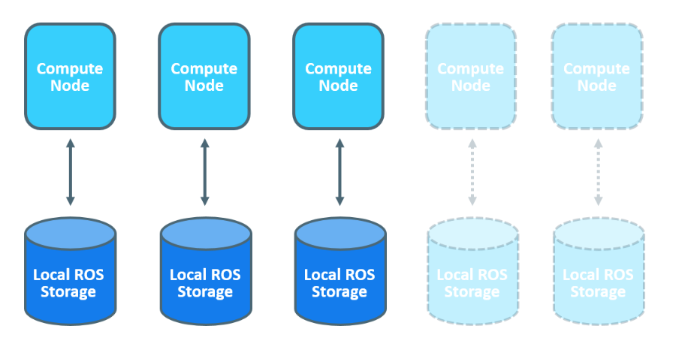
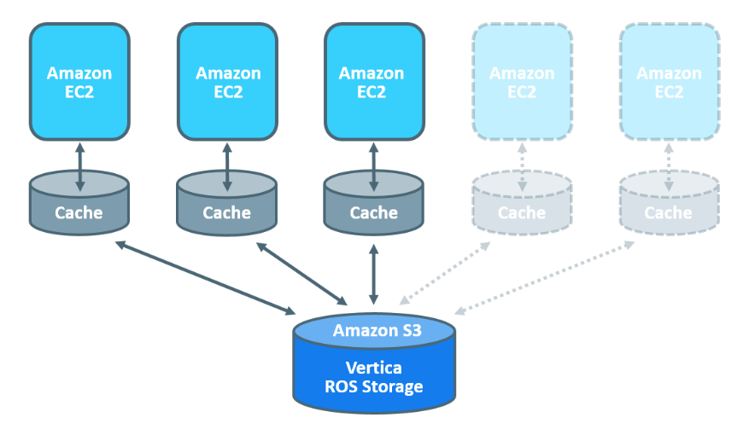
A New Way to Compute at Scale
Tightly coupled compute and storage, or cloud-optimized compute and storage separation?
Compute Where the Data Is
(On-premises, Cloud, or Hybrid)
Spin Up Compute As Needed
(Cloud)
Tightly coupled compute and storage resources for customers with a uniform workload and fixed performance expectations.
Capitalize on cloud economics and dynamic workloads by scaling compute resources independent of shared storage.

Slide 38





Analyze in near real-time
40-60 billion rows of data / day
Provide results to 1000+ employees
  Scale up analytics cluster 70 times for both Poker and Words With Friends in their fifth year
  Run 400-600 concurrent A/B tests

Slide 39


Goal: Attract online gamers with ‘free-to-play’ sessions and convert them to loyal ‘pay-to-play’ customers
  200 millisecond query response enables games to dynamically respond to player behavior in real-time
  350% boost in player engagement
  600% increase in revenue
  Keep both novices and experts engaged with game difficulty that
  adjusts to perceived player skill levels
Notes:
deltaDNA
http://files.asset.microfocus.com/6773/en/6773.pdf
The burgeoning appetite for games has attracted growing numbers of game developers, and competition among them is fierce. The market’s shift away from “pay-to-play” to “free-to-play” gaming experiences means that developers can no longer rely on up-front fees as a revenue source. Instead, they must attract players with free gaming experiences and turn those players into engaged and loyal fans. Only then can they convert those players into paying customers.
Unfortunately, for most games, engagement rates aren’t high enough to support a pay-to-play model. On average, only 20-40% of game players return for a second session. That’s about half the rate required for games to be commercially viable.
Which is why deltaDNA offers a sophisticated player analytics application—a solution that leverages Vertica software, the analytics engine of the Haven Big Data Platform, to enable developers to understand and react to player behavior in near real-time.
“Developers can use data to maximize player engagement,” explains Mark Robinson, CEO, deltaDNA. “And when they do that, the revenue will come.”
Vertica software is a key enabling technology for this capability. “To build our analytics platform, we needed the ability to perform very fast queries on large amounts of data, equating to billions of events per month,” says Robinson. “The Vertica architecture is uniquely powerful in this regard. It returns query results sixty times faster than other tools we benchmarked.”
99.9% of messages processed in 200 milliseconds
The impressive query speed of Vertica software is more than a technological accomplishment. It enables deltaDNA to deliver crucial capabilities to game developers: they can design games that analyze and respond to player behavior in a matter of milliseconds, even on huge data sets. “Overall, our solution processes 99.9% of messages within 200 milliseconds,” notes Robinson.
This is fast enough to be considered real-time and means that games can respond dynamically to player behavior as it occurs. “In the ideal gaming experience, players are kept in a state of slight anxiety,” Robinson explains. “The game experience balances players somewhere between feelings of comfort and loss of control.” As players meander between those two extremes, time is of the essence.
The deltaDNA analytics solution also allows developers to collect more data than ever before—and, because it takes advantage of Vertica software’s fast analytics capabilities, capturing vast, rich data sets no longer requires trade-offs in terms of query speed. “We’re enabling fame developers to truly embrace big data for the first time,” says Robinson. “Some of our developers’ games have 7-10 million monthly active users. A single game of this size can generate billions of records every month. But thanks to Vertica, our analytics can scale to these levels without losing speed or flexibility.”

Slide 40



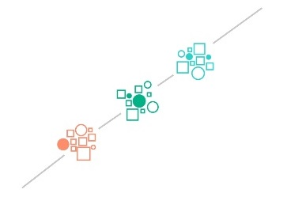
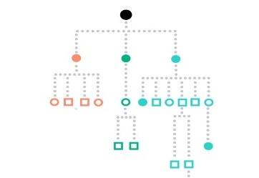
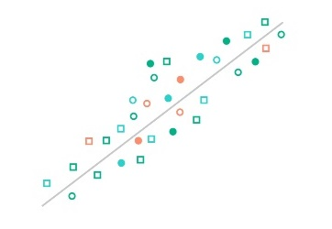
Machine Learning Wave
How you know you’re in it?
Users looking to move from descriptive to predictive analytics
New analytical challenges that aren’t handled in SQL
Creating differentiation through analytics
Solution
In-database machine learning
K-Means Clustering
Logistic Regression
Linear Regression
…etc.

Slide 41
Machine Learning
Increase Revenue and Customer Satisfaction
Predictive Maintenance
Ensuring Quality of Service
Proactive Sales
Targeted Marketing
Opening New Products & Markets
Differentiation

Slide 42
Benefits of In-database Machine Learning
In-database machine learning transforms the way data scientists and analysts interact with data
Scale
Speed
Accuracy
Democratized predictive analytics applications
Faster time to market for
machine learning projects
Deploy predictive use
cases and stay ahead
Empower more users within your organization to leverage machine learning with a simple SQL interface
You need massively parallel processing power to build and train models at the speed of business
Run machine learning models based on all your historical data, not just a subset of
downsampled data

Slide 43
Advantages of In-Database Machine Learning
Eliminating overhead of data transfer
Data security and provenance
Model storage and management
Serving concurrent users
Highly scalable, high performance machine learning functionalities
Avoiding maintenance cost of a separate analytical system
Node 1
Node 2
Node 3
Schema
Schema
Schema
Tables
Tables
Tables
Models
Models
Models
Network

Slide 44
End-to-End Machine Learning Process
Business Understanding
Data Analysis
Data Preparation
Modeling
Evaluation
Deployment
SQL
SQL
SQL
SQL
SQL
Notes:
Vertica covers a wide spectrum of advanced data analysis functionalities like data discovery, data preparation, model training, model evaluation, in-db scoring, and model management.
Data Preparation
Ingest, join, aggregate, derive, structure, explore, hypothesize, and clean iteratively at unlimited scale.
Modeling
Create advanced models on massive datasets with optimized MPP distributed algorithms via SQL
Evaluation
Model-level statistics, ROC tables, confusion matrices
Model health metrics
Deployment
Deploy quickly at any speed or scale with simple SQL calls
Model management and security

Slide 45
End-to-End Machine Learning Management
Predictive analytics process supported internal to database
+
+
SQL Database
Analytics & ML
Query Engine
Data Analysis
Data Preparation
Modeling
Evaluation
Deployment
• Statistical Summary
• Time Series
• Sessionize
• Pattern Matching
• Date/Time Algebra
• Window Partition
• Sequences
• And more…
• Outlier Detection
• Normalization
• Imbalanced Data
Processing
• Sampling
• Missing Value
Imputation
• And More…
• SVM
• Random Forests
• Logistic Regression
• Linear Regression
• Ridge Regression
• Naïve Bayes
• Cross Validation
• And More…
• Model-level Stats
• ROC Tables
• Error Rate
• Lift Table
• Confusion Matrix
• R-Squared
• MSE
• And More…
• Deploy Anywhere
• In Database Scoring
• Massively Parallel
Processing
• Speed
• Scale
• Security
• And More…

Slide 46






Popular Machine Learning Algorithms
Classification, clustering, time series, and predictive applications
+
+
SQL Database
Analytics & ML
Query Engine
Data Analysis
Data Preparation
Modeling
Evaluation
Deployment
Linear
Regression
Logistic
Regression
K-Means
Clustering
Naive
Bayes
Support Vector
Machines
Random
Forrest

Slide 47

Fidelis Cybersecurity protects the world's most sensitive data by identifying and removing attackers no matter where they're hiding on your network and endpoints.
Data science team was experiencing challenges with performance while using Spark ML
Moving workloads from Spark ML to in-database ML provided:
Speed of analytics
Ease of use when coding in SQL
Increased accuracy of models
Notes:
“Vertica’s new in-database machine learning capabilities are like gold! We are extremely excited to train our Machine Learning models on our data in Vertica and ship them with our platform to run on our customers’ clusters. This is something that is much harder with any other tool. Vertica’s in-database machine learning will improve our ability to offer new predictive analytics features quickly and easily to our growing customer base. It will improve our competitive positioning.”
- Abhishek Sharma, Data Scientist at Fidelis Cybersecurity

Slide 48
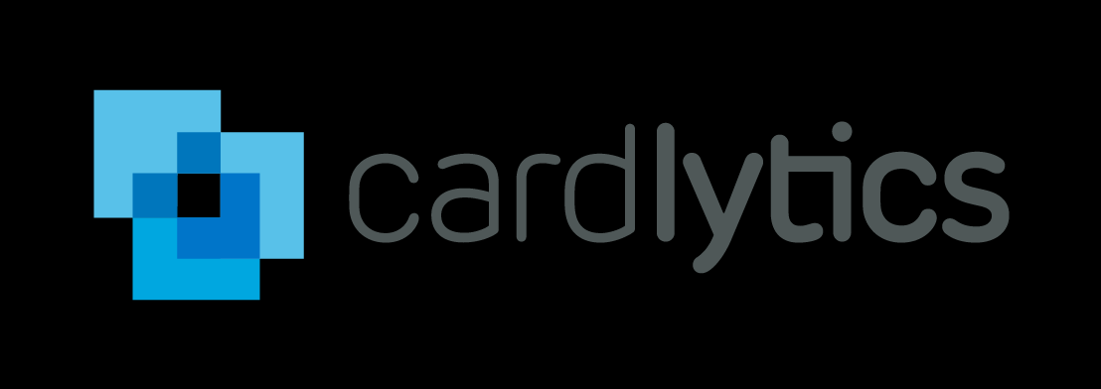

Cardlytics partners with more than 1,500 financial institutions to run their online and mobile banking rewards programs, which gives us a robust view into where and when consumers are spending their money.
Moving data science workloads from Spark on Hadoop to in-database
Improvements in stability and performance
Creating customer segmentation via clustering algorithms on a
15 million customer dataset took 24 mins on Spark - 3 mins in database
Concurrently running other algorithms without performance impact

Slide 49
Internet of Things Wave
How do you know you’re in it?
You’ve got a lot of data from sensors and devices
You spend a lot of time down-sampling so it’ll fit
Solutions needed for new analytical problems
  Predictive maintenance
  Fraud detection
  Product Recommendations
  Network optimization
  Cybersecurity
Solution
Support for IOT with petabyte scale
Integration with Kafka and Spark
Accelerates large-scale analytics
  Time series
  Geospatial
  Machine learning

Slide 50

Connected everything
Product delivery
Air quality
Product electronics & entertainment
Pumps
Security
Asset tracking
Noise
Telecom infrastructure
Air conditioner
Access control
Electricity switch
Vibration
Lighting
Traffic lights
Digital signage
Connected car
Vehicle leasing
Power distribution
Driver behavior
Roadside equipment
Fire & emergency
Notes:
The Internet of Things is already upon us. While the ultimate impact and use for all this information is ever expanding this is not some hype-cycle technology it is already impacting our lives today. Information is coming at us from many directions and the ability to ingest, inspect, analyze, advise, and take action quickly in near real time will determine how effectively we can serve citizens and defend our country.

Slide 51
Key Capabilities
Fast
Ingest a lot of data and ingest data constantly
Scalable
Handles huge workloads at high speeds
Economical
Significantly lower cost over legacy platforms

Slide 52

Drives Manufacturing Excellence
  Goal: Faster decisions and analytical insight on manufacturing plant assets
  Collects, organizes, processes and stores data from 50 billion semiconductors and printed circuit boards / year
  Faster indexing, granularity, and query response times – analytics on 2 billion data points in < 1 minute
  Runs a performance demo in 2.5 minutes against 200,000 equipment test results
Notes:
Optimal Plus analysts create historical baselines, form models from the history, and launch the models into customer facilities to predict faults and prevent downtime.
Optimal Plus -- http://files.asset.microfocus.com/8672/en/8672.pdf
COMPANY: Headquartered in Holon, Israel, Optimal Plus last year processed data on 50 billion ICs and boards, which was up 15 billion year over year. Compared to homegrown data-collection alternatives, the company’s holistic software enables seamless visibility across distributed supply chains. Developed for the Industrial Internet of Things (IIoT), the software connects to various plant assets, sensors, and devices to record, store, and analyze continuous streams of data.
SOLUTION: The company considered EXASOL, ParAccel, and Vertica solutions.
RESULTS: During tests, Schuldenfrei and Alon Malki, the company’s Chief Architect, saw that they could load and process data in the database at speeds which were significantly faster than with their legacy database. “One of our key buying factors is that Vertica’s performance overall is excellent on huge volumes of data,” Schuldenfrei said. “This helps accelerate the speed of decisions and analytical insight.”
Optimal Plus addressed its scalability requirements, as Vertica uses commodity servers instead of expensive, specialized brands. That will make horizontal scalability cost efficient and practically endless. Additionally, the high compression rate of Vertica can generate significant savings.
Using Vertica, Optimal Plus can compare historical data with almost-instant test information to predict faults and prevent downtime. Optimal Plus analysts create historical baselines, form models from the history, and launch the models into customer facilities to receive actionable insights. Malki notes that 95% of customer data resides in Vertica, which functions as an index on top of Hadoop software.
Primary software
Optimal Plus GlobalOps
Vertica Analytics Platform
Apache Hadoop

Slide 53


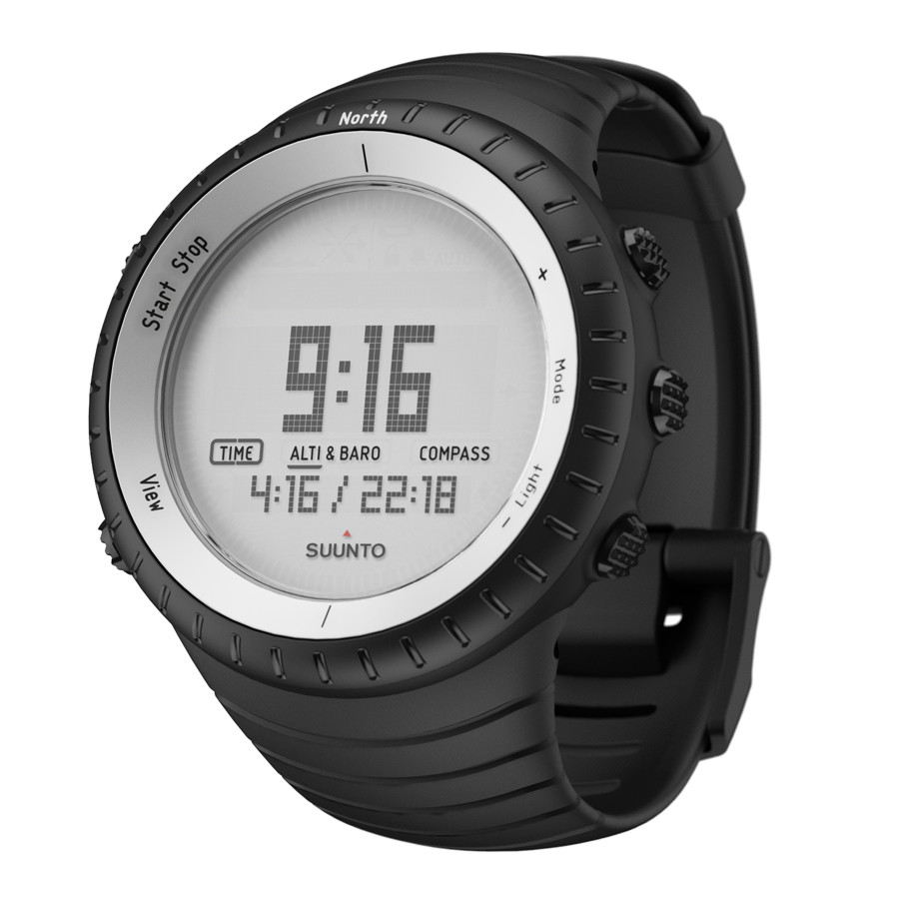

Slide 54



Captures 100 billion performance counters daily
Goal: Provide real-time data to help telcos optimize networks and resources
  Provides data from 35-75+ network interfaces for use in resolving network issues
  Affords 80-90% in hardware operational savings versus running data loads on traditional databases
  Saves an 18-member engineering team 36 hours per day in aggregating data for reports and analyses
Notes:
A well-known telco uses SysMech’s Zen Network Management Software, which incorporates Vertica, to congregate massive complex data from 75 various sources and relay information to hundreds of users.
System Mechanics Ltd. -- https://6a591c343feca4293cdf-0b0c1667178d3ae82bcda513f1915472.ssl.cf1.rackcdn.com/3537/en/3537.pdf
COMPANY: Telecommunications companies across the globe face an increasingly competitive landscape as they try to fulfill ever-increasing customer demands while facing more regulation and competition from Over the Top (OTT) applications and trying to reduce the operational costs of their networks. With Micro Focus® Vertica, SysMech gives telcos on-the-spot information and operational intelligence to optimize their networks.
SOLUTION: “We help operators understand more of their network and services with just one tool,” says Andy Stubley, Chief Operations Officer for SysMech.
RESULTS: A well-known telco uses SysMech’s Zen Network Management Software, which incorporates Vertica, to congregate massive complex data from 75 various sources and relay information to hundreds of users.
At another telco operator, a team of 80 engineers previously took two hours each to aggregate data from various areas of the network to conduct their analyses and run reports at the start of the day. Now a streamlined dashboard, enhanced with Vertica, assimilates all of the data and provides visibility across the network before the engineering team arrives, saving up to two hours per engineer per day. Vertica assists in profiling end users of telco services, driving behavior, and monetizing services.
Primary software
Zen Network Management Software
Micro Focus Vertica Analytical Platform
Tableau Software

Slide 55

Embedded Wave
How you know you’re in it?
You’re building solutions and you need to provide:
  Differentiated Analytic Capabilities
  Scalable User Access
  Entirely New Applications
  Reduced Customer Costs
  Aggressive Performance SLAs
Solution
Software-only solution not tied to any particular hardware or particular Cloud
Embeddable analytics with good price and performance
Fast analytics at unlimited scale for differentiation and customer satisfaction

Slide 56

Big Data creates massive opportunity for OEM vendors
Scalable User Access
Differentiated Analytic Capabilities
Entirely New Applications
Aggressive Performance SLAs
Reduced Customer Costs

Slide 57







OEM software vendors need to embed analytics software that can:
Manage huge data volumes
Deliver fast analytics
Embed machine learning
Allow user-defined functions (UDx)
Support data scientists
Handle high user concurrency
Require minimal administration
Notes:
Use Cases for each of these areas:
Improve Products –
Personalize Service –
Improve Loyalty –
Cross-Sell Up-Sell –
Improve Operations –
Predict Outcomes –
Maximize Margins

Slide 58


Results of Embedding a Powerful Analytics Engine
OEM software developers
Faster insights into consumer
sales trends, resulting in 28
percent revenue increase
Experienced 351% ROI
with an average
annual benefit of $3,014,583
Jobs that took 20 minutes
now take 20 seconds.
A 6,000% improvement.
Near real-time data insertion
at the scale of hundreds of
thousands of endpoints
Player engagement increased by up to 350%, helping drive customer retention and loyalty
Analytics on 2 billion data points done in less than a minute
Notes:
This is a sample Table slide, ideal for comparing data by year, product, revenues, etc.
To Customize and Edit this Table, follow the steps below (this applies to all slides in this template that contain tables):
To Change Text in Table:
Select text in table. Begin typing desired text. To move from one cell to another, press Tab.
To Change Font Color/Size:
Select text and adjust the font setting in the Font group in the Home tab. Select desired attributes to change: font, size, boldness, color, etc. Note: many of the same commands can also be accessed from the Mini toolbar.
To Insert or Delete Rows in Table:
To delete a row place cursor in a cell of the row, right-click for a pop up menu, select Delete Row.
To Insert a row, place cursor in the row you want to place a row before, right-click for a pop up menu, select Insert and make a selection from the submenu.
You can also use the Insert and Delete Rows and Columns tools on the Table Tools Layout tab to perform these actions.
To Insert or Delete Columns in Table:
To delete a column, place cursor above the column (you will see a solid downward pointing arrow) click to select the column, right-click on the selected column, chose Delete Column from the pop up menu.
To insert a column, place cursor above the column you wish to insert the new column before (you will see a solid downward pointing arrow) click to select the column, right-click for a pop up menu, select Insert and make a selection from the submenu.
You can also use the Insert and Delete Rows and Columns tools on the Table Tools Layout tab to perform these actions.
To Highlight the Text Color in a Cell, Column or Row (for emphasis):
Click to select an individual cell or click and drag through the desired column(s) or row(s). From the Home tab, in the Font group, select Bold.
While a table is selected, other formatting options are available on the Table Tools Design and Layout tabs.
To Customize the Default Table Style (ie: when you insert a table from scratch vs. copy/paste a sample table shown in this template):
Step 1: Insert a table (style defaults to Light Style 2. Accent 6)
Step 2: Select the entire table
Step 4: On the Table Tools Design tab, click the arrow next to Borders and choose Left Border and then click the Borders button to turn off (toggle) the left border.
Step 4: Repeat step 4 to turn off the Right border.

Slide 59
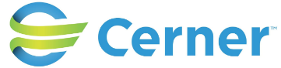

A Day in The Life
Applications and services that enable our data-driven world
Smart
Buildings
Health / EMR Analytics
Ride
Share
Customer
Analytics
Network
Optimization
Predictive
Maintenance
Route
Optimization
Wearable
Analytics
Smart
Agriculture
Software
Optimization
Clickstream
Analytics
Security
Analysis
Notes:
Thousands of companies across the world in a very wide range of industries rely on Vertica to analyze their data.
It means that millions of people around the globe use services from companies that are empowered by Vertica.
You might be among them as well!
Do you take ride from Uber? Have you done shopping from GUESS or Wayfair? Have you used tax preparation services like TurboTax from Intuit?

Slide 60

Take-Aways
Embrace disruptions, but:
  Don’t jump too fast into unproven technology
  Understand the capabilities you need before you embrace
  Don’t fall for vendor lock-in
  Consider open platforms and multiple technologies
  Have a business-based use case and track the value
Use analytics to innovate and differentiate
Leverage disruptions to increase revenue, improve efficiency, compliance, customer satisfaction, reduce costs, …
Plan for the future. Don’t get locked in.

Slide 61
Thank you
www.vertica.com

Slide 62
Try Vertica
vertica.com/try
3 Easy ways to try Vertica (https://www.vertica.com/try/)
  Get Started in Minutes with Vertica by the Hour from AWS Marketplace, Google Cloud or Microsoft Azure
  Free Community Edition (for up to 1TB and 3-node cluster)
  Vertica Start-Up Accelerator Program (Free 1-year term, 25 TB license)

Slide 63

  Goal: Manage patient and provider risk and foster wellness with user friendly BI applications
  “analyze data at the speed of thought” – ZACHARIA MATHEW, Dir of Analytics, hMetrix LLC
  70x improved query response time
  Serve 50% more customers – enabling additional revenue-generating solutions
  Real-time analytics of billions of complex US Medicare/Medicaid claims and clinical records
Notes:
Link to case study: http://files.asset.microfocus.com/8605/en/8605.pdf
hMetrix is in the healthcare industry, where it helps healthcare stakeholders manage patient risk and foster wellness by delivering user-friendly, business intelligence solutions. They have Implemented a big data solution in the cloud to enable analytics of complex patient and clinical data.
COMPANY: Privately held hMetrix LLC offers healthcare business intelligence and data science solutions, which help payers, employers, health systems, the government, providers, and care management companies manage risk, data, and reimbursements. Ninety percent of hMetrix’s diverse client portfolio consists of repeat clients. Although the company has only 70 employees, its product slate enables the consulting firm to compete with large healthcare solution providers in the field. In ramping up for a project, the 12-year-old company must staff quickly, launch the appropriate infrastructure, and produce timely results.
SOLUTION: hMetrix leverages an Vertica data analytics platform on which to provide established products like a self-service analytics tool for care managers overseeing many patients. The platform also supports another hMetrix product, “Episode Analytics,” that helps hospitals effectively manage risk in compliance with new government regulations concerning Bundled Payments.

