Slide 1
Identity & Access Management in a Cloudy World
Eric Raff
10/11/2018

Slide 2

Who am I
In IT industry for 22+ years
Director of Cloud Practice – JourneyTEAM
Cloud Solutions Architect
Identity & Access Management Architect
SharePoint Architect
Exchange Server Engineer
OCS/Lync Engineer
GroupWise Guy
Published Author
Teacher

Slide 3
What is IAM, really?
Authentication
  Who are you
Authorization
  What you have access too
Identity Governance
  Provisioning/de-provisioning
  Lifecycle management
Auditing
  Access Review
  Attestation

Slide 4
Network Centric Security is so 20th Century
Castle Approach – Protect the perimeter is dead
  Data use and access has exploded
  People, Partners, Cloud, Mobile, etc.
  Need for better solutions to access data
People and data are no longer related to the network
On-prem vs. Cloud vs. Mobile
No more Boundaries or Castle Walls

Slide 5
The world we live in is hyper connected
G
Employees
Partners
Customers
Distributors
Suppliers
Devices
Things

Slide 6
Identity is the control plane
Identity

Slide 7
You Need an Identity Centric Approach
(not a network one)
The Currency of security are Identities
  Right Access
  Right People
  Right Data
  Right Time
If you don’t control the currency you are at risk

Slide 8





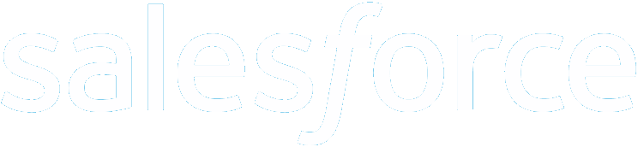





What No Identity Strategy Looks Like
Customers
Partners
SaaS
Azure
Public
cloud
Windows Server
Active Directory
Cloud
BYO
On-premises
VPN

Slide 9



What an Identity Strategy Looks Like
Customers
Partners
Azure
Public
cloud
Windows Server
Active Directory
Identity Provider
(Think Okta or AzureAD)
Cloud
BYO
On-premises
VPN

Slide 10
What an Identity Strategy Looks Like
Customers
Partners
Azure
Public
cloud
Windows Server
Active Directory
Identity Provider
(Think Okta or AzureAD)
Cloud
BYO
On-premises

Slide 11
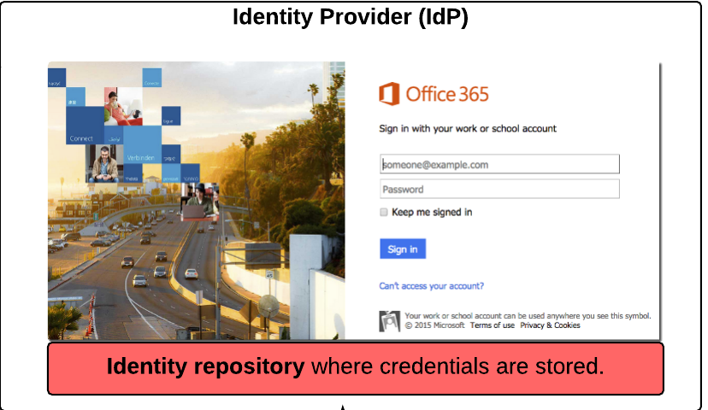
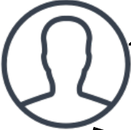
Federated AuthN Patterns – the FUTURE!
2) User is redirected to IdP, is AuthN and requests identity token
3) IdP asserts users identity in form of assertion, token or claim
1) Trust Relationship
4) User presents token to app or service where app validates it came from trusted issuer.
Federation aware App or Service
(Relying Party /Service Provider)

Slide 12
A Note About SSO vs User Profile / Provisioning
Which comes first the AuthN or the App User Profile?
AuthN flow may or may not be same as User Profile (provisioning and profile update/de-provisioning)
SSO
Provisioning &
de-provisioning
Identity Provider
(Think Okta or AzureAD)

Slide 13
Overall Identity Cloud Strategy Components
Guiding Principles
  Define the overall guiding principles and philosophy that your business uses as it looks to adopt various cloud services in general.
    Build vs. buy
    Strategic Vendor vs. best of breed
    Change business process for OOTB functionality vs. Customize
Identity and Access Management (IDaaS)
  AuthN
  AuthZ
  Provisioning
SaaS
  Product Owner

Slide 14
My Apps Don’t Support SSO
Password Vaulting option
  “Poor-mans SSO”
AzureAD App Proxy
  Integrate on-prem App with SSO Identity Provider
  Access from outside corp network using same security posture as SaaS apps

Slide 15
Securing User Identities In the Cloud
True or False:
  Your Identities can be better secured when in the Cloud than when on-prem?
What is sitting between your data (on-prem or cloud) and a bad actor with good credentials?
  Bad actors can get good user creds in the world we live in today
  Who has been a target of spear phishing?

Slide 16
Securing User Identities In the Cloud
Multi Factor Authetnication (MFA) = 2 or more of…
  Something I know
  Something I have
  Somthing I am
GEO Fencing – there are better solutions
Device enrollment and management
Adaptive realtime risk based adjustments

Slide 17
What’s available / coming
Password less login – Available Now
Hard Tokens - Coming soon
Device Based Compliance triggers MFA or not - Avail Now
Access Reviews – Avail Now
Conditional Access options – Avail Now
  Users, groups or roles scoped (include/exclude)
  Application scope (include/exclude)
  Sign in Risk (Leaked Credentials, Risky logins)
  Device Platform (iOS, Android, MacOS, Windows)
  GEO-Location / trusted networks (include/exclude)
  Session Management
    O365 services, Federated integrations to Azure AD

Slide 18
VERY High Level view of the Microsoft Cloud
Microsoft Office 365 Services (SaaS) – https://portal.office.com
Exchange Online
SharePoint
Online
(OneDrive for business)
Microsoft
Teams
Skype for Business
Planner
Flow/PowerApps
Yammer
Dynamics 365
Microsoft Azure Services (IaaS / PaaS) | https://portal.azure.com
A Z U R E A C T I V E D I R E C T O R Y (AAD) | I N T U N E (MDM/MAM) | Azure Information Protection (AIP)
Compute
Web + Mobile
Internet of Things
Developer tools
Networking
Databases
Enterprise Integration
Monitoring + management
Storage
Intelligence + analytics
Security + Identity
Containers
Microsoft Datacenters / 54 Regions with 10 more announced – physical infrastructure

Slide 19
Key Takeaways
Enable MFA – Make it smart
Understand Device state / Compliance and integrate with AuthN context
Get Apps Integrated via SSO
  Federated method is preferred
Life cycle management can provide big benefits
  “HR as a Master” – Get HR Dept on board
Attribute Management – the future of Authorization
  Dynamic Attribute based groups/access

